Slide 1
Module 3 – Advanced Features:
Part I - Structural Diagrams

Slide 2
3 basic building blocks of UML - Diagrams
Graphical representation of a set of elements.
Represented by a connected graph: Vertices are things; Arcs are relationships/behaviors.
5 most common views built from
UML 1.x: 9 diagram types.
UML 2.0: 12 diagram types
Structural Diagrams
Represent the static aspects of a system.
  Class;
  Object
  Component
  Deployment
Structural Diagrams
  Class;
  Object
  Component
  Deployment
  Composite Structure
  Package
Behavioral Diagrams
Represent the dynamic aspects.
  Use case
  Sequence;
  Collaboration
  Statechart
  Activity
Behavioral Diagrams
  Use case
  Statechart
  Activity
Interaction Diagrams
  Sequence;
  Communication
  Interaction Overview
  Timing

Slide 3
Class Diagrams
Structural Diagrams
  Class;
  Object
  Component
  Deployment
  Composite Structure
  Package

Slide 4
Class Diagram
The basis for all object modeling
All things lead to this
Most common diagram.
Shows a set of classes, interfaces, and collaborations and their relationships (dependency, generalization, association and realization); notes too.
Represents the static view of a system (With active classes, static process view)
Three modeling perspectives for Class Diagram
Conceptual: the diagram reflects the domain
Specification: focus on interfaces of the software (Java supports interfaces)
Implementation: class (logical database schema) definition to be implemented in code and database.
Most users of OO methods take an implementation perspective, which is a shame because the other perspectives are often more useful. -- Martin Fowler

Slide 5
Names
Classes
type/class
Account
simple name - start w. upper case
balance: Real = 0
default value
Attributes
<<constructor>>
+addAccount()
<<process>>
+setBalance( a : Account)
+getBalance(a: Account): Amount
…
<<query>>
isValid( loginID : String): Boolean
short noun - start w. lower case
Operations
signature
may cause object to
change state
ellipsis for additional
attributes or operations
stereotypes to categorize
Bank
Customer
only the name compartment, ok
Java::awt::Polygon
path name = package name ::package name::name

Slide 6
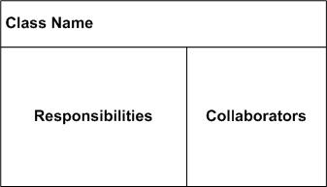
Responsibilities
Account
Responsibilities
-- handles deposits
-- reports fraud to managers
anything that a class knows or does
(Contract or obligation)
An optional 4th item carried out by attributes and operations.
Free-form text; one phrase per responsibility.
Technique - CRC cards (Class-Responsibility-Collaborator); Kent Beck and Ward Cunningham’89
A collaborator is also a class which the (current) class interacts with to fulfill a responsibility
Customer
Account
Opens account
Knows name
Knows address
Account
Knows interest rate
Knows balance
Handles deposits
Reports fraud to
manager
Manager

Slide 7
Scope & Visibility
Instance Scope — each instance of the classifier holds its own value.
Class Scope — one value is held for all instances of the classifier (underlined).
Instance scope
Frame
class scope
header : FrameHeader
uniqueID : Long
public
+ addMessage( m : Message ) : Status
Public
class
Public
method
Public
attribute
# setCheckSum()
protected
- encrypt()
- getClassName()
Private
class
private
Protected
class
Public - access allowed for any outside classifier (+).
Protected - access allowed for any descendant of the classifier (#).
Private - access restricted to the classifier itself (-).
(using adornments in JBuilder)

Slide 8
Multiplicity
singleton
multiplicity
NetworkController
1
3
consolePort [ 2..* ] : Port
ControlRod
Using Design Pattern
Singleton
public class Singleton {
private static Singleton instance = null;
private Singleton() {}
public static Singleton getInstance() {
if (instance == null) {
instance = new Singleton();
}
return instance;
}
}
- instance
+ getInstance():Singleton
NetworkController
consolePort [ 2..* ] : Port
Notes:
Empty compartment
Stereotypes

Slide 9
Relationships
Window
Event
open()
close()
dependency
generalization
association
ConsoleWindow
DialogBox
Control
Controller
EmbeddedAgent
generalization
(multiple inheritance)
<<interface>>
URLStreamHandler
association navigation
SetTopController
authorizationLevel
PowerManager
openConnection()
parseURL()
setURL()
toExternalForm()
startUp()
shutDown()
Connect()
<<friend>>
ChannelIterator
realization
stereotyped dependency

Slide 10
Dependency
A change in one thing may affect another.
The most common dependency between two classes is one where one class <<use>>s another as a parameter to an operation.
AudioClip
name
Microphone
record(m:Microphone)
start()
stop()
dependency
Using relationship
CourseSchedule
addCourse(c : Course)
removeCourse(c : Course
Course
Usually initial class diagrams will not have any significant number of dependencies in the beginning of analysis but will as more details are identified.

Slide 11
Dependency – Among Classes
AbstractClass {abstract}
<<metaclass>>
<<interface>>
attribute
MetaClassName
InterfaceName
concreteOperation()
abstractOperation()
operation()
<<instanceOf>>
generalization
realization
ClassName
-simpleAttribute: Type = Default
#classAttribute: Type
+/derivedAttribute: Type
<<use>>
+operation(in arg: Type = Default): ReturnType
<<instanceOf>>
objectName: ClassName
ClientClass
Attribute = value
simpleAttribute: Type = Default
classAttribute: Type
/derivedAttribute: Type

Slide 12
Dependency –Among Classes
Eight Stereotypes of Dependency Among Classes
  bind: the source instantiates the target template using the given actual parameters
  derive: the source may be computed from the target
  friend: the source is given special visibility into the target
  instanceOf : the source object is an instance of the target classifier
  instantiate: the source creates instances of the target
  powertype: the target is a powertype of the source; a powertype is a classifier whose objects are all the children of a given parent
  refine: the source is at a finer degree of abstraction than the target
  use: the semantics of the source element depends on the semantics of the public part of the target

Slide 13
Dependency –Among Use Cases
Two Stereotypes of Dependency Among Use Cases:
  extend: the target use case extends the behavior of the source
  include: the source use case explicitly incorporates the behavior of another use case at a location specified by the source
System
Use Case A
Actor
<<include>>
<<extend>>
Order Processing System
Place Order
<<actor>>
Actor
Use Case B
Use Case C
Extension points
Additional requests:
after creation of
the order
<<extend>>
Request Catalog
1
*
The sales person
asks for the catalog
SalesPerson
<<include>>
<<include>>
<<include>>
Supply Customer Info.
Order Item
Make Payment

Slide 14
Generalization
Four Standard Constraints
  complete: all children in the generalization have been specified; no more children are permitted
  incomplete: not all children have been specified; additional children are permitted
  disjoint: objects of the parent have no more than one of the children as a type
  overlapping: objects of the parent may have more than one of the children as a type
One Stereotype
  implementation: the child inherits the implementation of the parent but does not make public nor support its interfaces

Slide 15
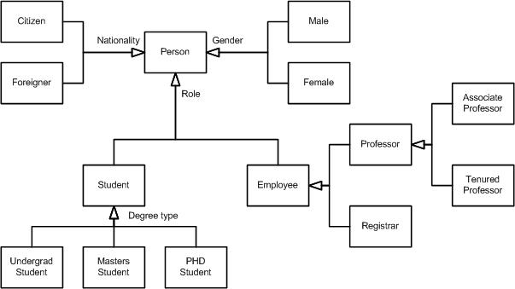
Generalization – Along Roles

Slide 16
Generalization –Among Actors
Place Order
Extension points
Additional requests:
after creation of the order
1
*
SalesPerson
Sales person can do only “Place Order”;
Sales manager can do both “Place Order”
and “Grant Credit”
Grant Credit
1
*
SalesManager

Slide 17
Associations
Represent conceptual relationships between classes
(cf. dependency with no communication/message passing)
direction indicator:
how to read relation name
navigability
relationship name
Professor
teaches
Course
*
1..*
teacher
class
role names
Multiplicity
defines the number of objects associated with an instance of the association.
  Default of 1;
  Zero or more (*);
  n..m; range from n to m inclusive
{visibility} {/} role name {: interface name}

Slide 18
Associations – A Question
How would you model the following situation?
“You have two files, say homework1 and myPet, where homework1 is read-accessible only by you, but myPet is write-accessible by anybody.”
You could create two classes, File and User.
Homework1 and MyPet are files, and you are a user.
File
User
<<instanceOf>>
<<instanceOf>>
homework1:File
u:User
myPet:File
anyoneElse: User
Approach 1: Now, would you associate the file access right with File?
Approach 2: Or, would you associate the file access right with User?

Slide 19
Associations – Links
  link is a semantic connection among objects.
  A link is an instance of an association.
association
class
class
association name
Worker
+setSalary( s : Salary)
+setDept( d : Dept)
1..*
works for
*
Company
employee
employer
?
<<instanceOf>>
<<instanceOf>>
w : Worker
assign(development)
: Company
link
named object
anonymous object
Association generalization is not automatic, but should be explicit in UML

Slide 20
Associations – Link Attributes
Link Attributes
The most compelling reason for having link attributes is for-many-to-many relationships
File
User
link attribute
access permission
Association Class
File
*
1..*
User
visual tie
AccessRight
access permission
association class
With a refactoring
1
1..*
AccessRight
*
1
File
User
access permission

Slide 21
Modeling Structural Relationships
Considering a bunch of classes and their association relationships
1
0..1
School
has
Department
1..*
1..*
1..*
1..*


assigned to
member
*
1..*
1..*
1
chairperson

*

1..*
Student
attends
Course
teaches
Instructor
*
*
The model above is from Rational Rose. How did the composite symbol ( )get loaded versus the aggregation? Use the Role Detail and select aggregation and then the “by value” radio button.

Slide 22

Modeling Structural Relationships
Aggregation
- structural association representing “whole/part” relationship.
“has-a” relationship.
multiplicity
whole
part
1..*
Company
Department
association
aggregation
Composite
Composite is a stronger form of aggregation.
Composite parts live and die with the whole.
Composite parts may belong to only one composite.
Car
Body
Part -> whole?
Body
Liver
Heart
Liver
Heart
Wheel
Engine
Can aggregations of objects be cyclic?

Slide 23
Association – Qualification
Bank
Qualifier,
cannot access person without knowing the account #
account #
*
0..1
Person
Chessboard
rank:Rank
file:File
1
1
Square
*
0..1
WorkDesk
jobId : int
returnedItem

Slide 24
Association – Interface Specifier
association
worker : IEmployee
*
Person
1
supervisor : IManager
Interface Specifier
Realization
A semantic relationship between classifiers in which one classifier specifies a contract that another guarantees to carry out.
In the context of interfaces and collaborations
An interface can be realized by many classes/components
A class/component may realize many interfaces
IManager
Person
getProject()
getSchedule()

Slide 25
Modeling a Logical Database
Class diagrams to provide more semantics
From a general class diagram, first identify classes whose state must be persistent (e.g. after you turn off the computer, the data survives, although the program doesn’t).
Create a class diagram using standard tagged value, (e.g. {persistent} ).
Include attributes and associations.
Use tools, if available, to transform logical design (e.g., tables and attributes) into physical design (e.g., layout of data on disk and indexing mechanisms for fast access to the data).
School
Department
0..1
{ persistent}
{ persistent}
name : Name
name : Name
address : String
phone : Number
1..*
addInstructor()
addStudent()
removeInstructor()
removeStudent()
getInstructor()
1..*
getStudent()
getAllInstructors()
getAllStudents()
addDepartment()
1..*
removeDepartment()
getDepartment()
getAllDepartments()
1..*
*
1..*
1..*
0..1
chairperson
Student
Course
Instructor
{ persistent}
{ persistent}
{ persistent}
name : Name
*
*
name : Name
*
1..*
name : Name
studentId : Number
courseId : Number

Slide 26
Forward/ Reverse Engineering
translate a collaboration into a logical database schema/operations
transform a model into code through a mapping to an implementation language.
Steps
  Selectively use UML to match language semantics (e.g. mapping multiple inheritance in a collaboration diagram into a programming language with only single inheritance mechanism).
  Use tagged values to identify language..
public abstract class EventHandler
{
private EventHandler successor;
private Integer currentEventId;
private String source;
EventHandler() {}
public void handleRequest() {}
}
successor
EventHandler
{ Java}
Client
currentEventId : Integer
{ Java}
source : Strings
handleRequest() : void
translate a logical database schema/operations into a collaboration
transform code into a model through mapping from a specific implementation language.

Slide 27
Object Diagrams
Structural Diagrams
  Class;
  Object
  Component
  Deployment
  Composite Structure
  Package

Slide 28
Instances & Object Diagrams
“instance” and “object” are largely synonymous; used interchangeably.
difference:
  instances of a class are called objects or instances; but
  instances of other abstractions (components, nodes, use cases, and associations) are not called objects but only instances.
What is an instance of an association called?
Object Diagrams
very useful in debugging process.
  walk through a scenario (e.g., according to use case flows).
  Identify the set of objects that collaborate in that scenario (e.g., from use case flows).
  Expose these object’s states, attribute values and links among these objects.

Slide 29
Instances & Objects - Visual Representation
named instance
anonymous instance
myCustomer
: Multimedia :: AudioStream
t : Transaction
: keyCode
c : Phone
[WaitingForAnswer]
agent :
multiobject
orphan instance
(type unknown)
instance with current state
r : FrameRenderThread
myCustomer
id : SSN = “432-89-1738”
active = True
active object
(with a thicker border; owns a thread or process and can initiate control activity)
instance with attribute values

Slide 30
Instances & Objects - Modeling Concrete Instances
Expose the stereotypes, tagged values, and attributes.
Show these instances and their relationships in an object diagram.
current: Transaction
primaryAgent
[searching]
<<instanceOf>>
LoanOfficer
current := retrieve()
: Transaction
Instances & Objects - Modeling Prototypical Instances
Show these instances and their relationships in an interaction diagram or an activity diagram.
2.1 : startBilling
1 : create
a: CallingAgent
c: Connection
2: enableConnection

Slide 31
Instances & Objects – More Examples
1: sort()
c : Company
list()
d: Directory
contents: File
s : Department
name = “Sales”
rd : Department
name = “R&D”
addFile(f:File)
1: addElement(f)
d: Directory
contents: File
secureAll()
1*: changeMode(readOnly)
uss : Department
name = “US Sales”
d: Directory
*
f: File
client
servers
:Server
manager
1: aServer := find(criteria)
erin : Person
name = “Erin”
employeeID = 4362
title = “VP of Sales”
aServer:Server
: ContactInfomation
address = “1472 Miller St.”
2: process(request)
call ::= label [guard] [“*”] [return-val-list “:=“] msg-name “(“ arg-list “)”

Slide 32
Component Diagrams
Structural Diagrams
  Class;
  Object
  Component
  Deployment
  Composite Structure
  Package

Slide 33
Component Diagram
UML1.x – implementation view
Shows a set of components and their relationships.
Represents the static implementation view of a system.
Components map to one or more classes, interfaces, or collaborations.
Mapping of Components into Classes
Components and their Relationships
loanOfficer.dll
component
Registrar.exe
LoanOfficer
CreditSearch
Course.dll
LoanPolicy
Student.dll
classes
Notes:
See UML text pg. 347 (figure 25-3) for an example.

Slide 34
Component Diagram
UML2.0 – architectural view
Big demand, hmm…
Short history behind architecture
Architecture still an emerging discipline
Challenges, a bumpy road ahead
UML and architecture evolving in parallel
Component diagram in need of better formalization and experimentation
Notes:
See UML text pg. 347 (figure 25-3) for an example.

Slide 35
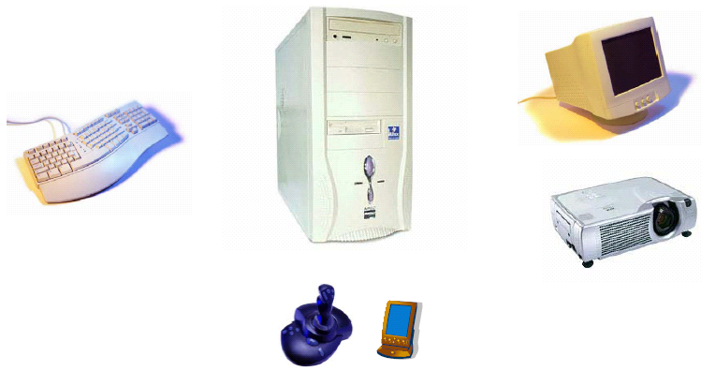
Component Diagram – another example
(www.cs.tut.fi/tapahtumat/olio2004/richardson.pdf)

Slide 36
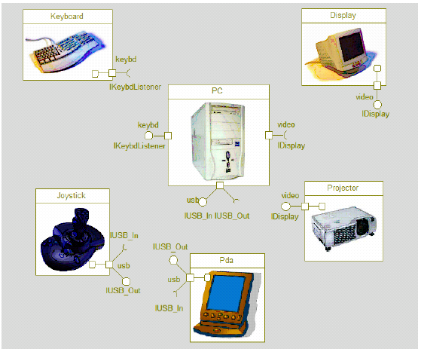
Component Diagram – another example
(www.cs.tut.fi/tapahtumat/olio2004/richardson.pdf)

Slide 37
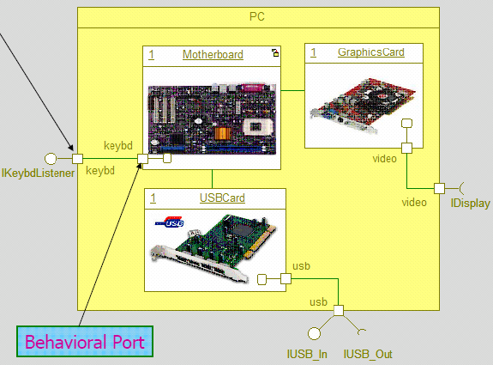
Component Diagram – another example
(www.cs.tut.fi/tapahtumat/olio2004/richardson.pdf)

Slide 38
Component Diagram
UML2.0 – architectural view
Explicit description of interfaces:
provided services to other components
requested services from other components
Component
lollipop
Component
socket
An interface is a collection of 1..* methods, and 0..* attributes
Interfaces can consist of synchronous and / or asynchronous operations
A port (square) is an interaction point between the component and its environment.
Can be named; Can support uni-directional (either provide or require) or bi-directional (both provide and require) communication; Can support multiple interfaces.
possibly concurrent interactions
fully isolate an object’s internals from its environment
caller or callee?
security
AccessControl
StudentAdministration
Student
Encription
Incoming signals/calls
Persistence
Outgoing signals/calls
StudentSchedule
Data[1..*]
DataAccess
Notes:
See UML text pg. 347 (figure 25-3) for an example.

Slide 39
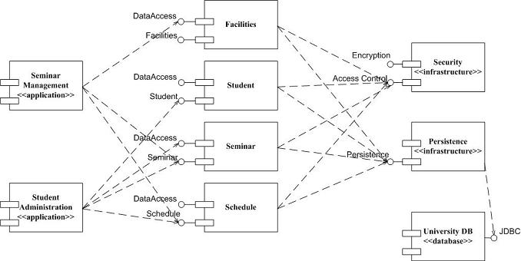
Component Diagram: UML 1.x and UML 2.0
(http://www.agilemodeling.com/artifacts/componentDiagram.htm)

Slide 40
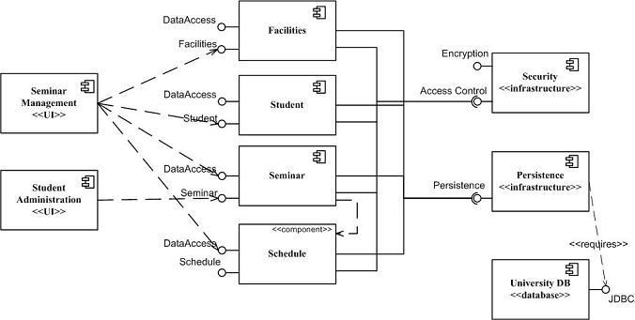
Component Diagram: UML 1.x and UML 2.0
(http://www.agilemodeling.com/artifacts/componentDiagram.htm)
So, how many different conventions for components in UML2.0?

Slide 41
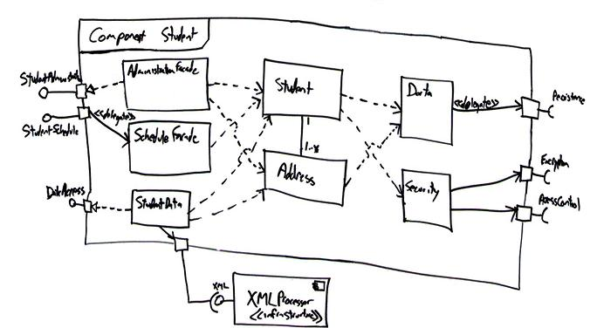
Building a Component
simplified the ports to either provide or require a single interface
relationships between ports and internal classes in three different ways:
i) as stereotyped delegates (flow), as delegates, and as realizes (logical->physical) relationships
Cohesive reuse and change of classes; acyclic component dependency ???
.

Slide 42
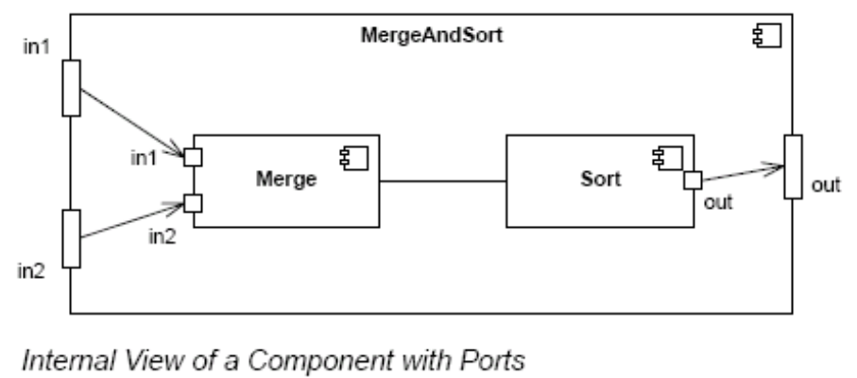
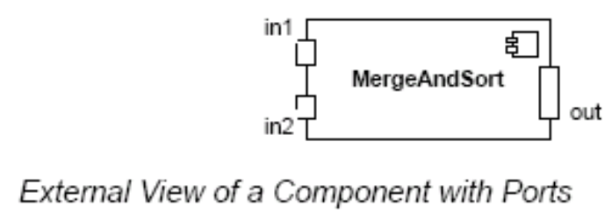
Component Diagram – Connector & Another Example
a connector: just a link between two or more connectable elements (e.g., ports or interfaces)
2 kinds of connectors: assembly and delegation. For “wiring”
  An assembly connector: a binding between a provided interface and a required interface (or ports) that indicates that one component provides the services required by another; simple line/ball-and-socket/lollipop-socket notation
  A delegation connector binds a component’s external behavior (as specified at a port) to an internal realization of that behavior by one of its parts (provide-provide, request-request).
delegation
delegation
assembly
connector
store
Left delegation: direction of arrowhead indicates
“provides”
So, what levels of abstractions for connections?
Right delegation: direction of arrowhead indicates
“requests”
Notes:
See UML text pg. 347 (figure 25-3) for an example.

Slide 43
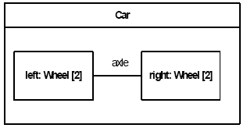
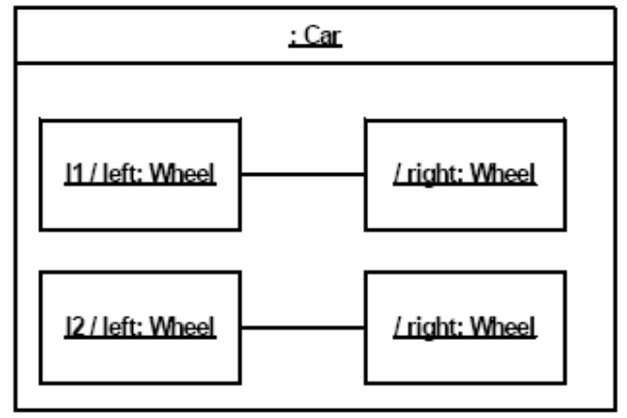
Structured Class
A structured class(ifier) is defined, in whole or in part, in terms of a number of parts - contained instances owned or referenced by the structured class(ifier).
With a similar meaning to a composition relation
A structured classifier’s parts are created within the containing classifier (either when the structured classifier is created or later) and are destroyed when the containing classifier is destroyed.
Like classes and components, combine the descriptive capabilities of structured classifiers with ports and interfaces
Any difference?
component or
class?
connector
label /roleName : type
Components extend classes with additional features such as
the ability to own more types of elements than classes can; e.g., packages, constraints, use cases, and artifacts
deployment specifications that define the execution parameters of a component deployed to a node

Slide 44
Classifiers
Classifier—mechanism that describes structural (e.g. class attributes) and behavioral (e.g. class operations) features. In general, those modeling elements that can have instances are called classifiers.
cf. Packages and generalization relationships do not have instances.
an asynchronous stimulus
communicated between instances
class
class
signal
interface
signal
interface
Shape
Shape
data type
data type
<<signal>>
<<signal>>
OffHook
IUnknown
OffHook
origin
origin
<<type>>
<<type>>
Int
move()
Int
move()
{ values range from
resize()
{ values range from
resize()
-2**31 to +2**31 - 1 }
display()
-2**31 to +2**31 - 1 }
display()
use case
use case
Process loan
Process loan
egb_server
membership_server
kernel32.dll
kernel32.dll
<<subsystem>>
<<subsystem>>
Customer Service
Customer Service
node
component
node
component
subsystem
Generalizable Element, Classifier, Class, Component?

Slide 45
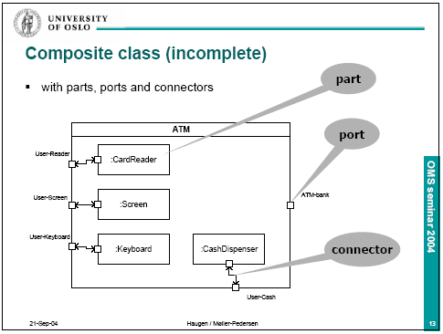
Structured Class – Another Example
what kind?

Slide 46
Deployment Diagrams
Structural Diagrams
  Class;
  Object
  Component
  Deployment
  Composite Structure
  Package

Slide 47
Deployment Diagram
Shows a set of processing nodes and their relationships.
Represents the static deployment view of an architecture.
Nodes typically enclose one or more components.
TCP/IP
IIS + PhP Server
TCP/IP
J2EE Server
Membership Server
DecNet
Tomcat Server

Slide 48
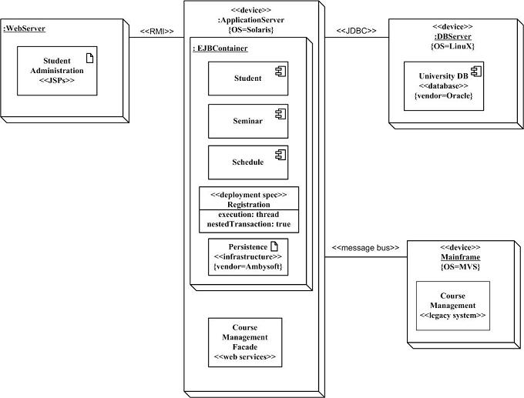
Structural Diagrams - Deployment Diagram
(http://www.agilemodeling.com/artifacts/deploymentDiagram.htm)
Student administration application
Physical nodes - stereotype device
WebServer - physical device or
software artifact
RMI/message bus: connection type
Nodes can contain other nodes
or software artifacts recursively
Deployment specs: configuration files:
name and properties

Slide 49
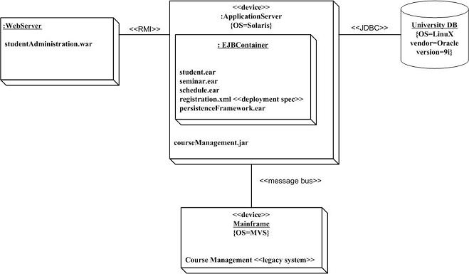
Structural Diagrams - Deployment Diagram
(http://www.agilemodeling.com/artifacts/deploymentDiagram.htm)
Is this better?
More concrete
Implementation-oriented

Slide 50
Composite Structure Diagrams
Structural Diagrams
  Class;
  Object
  Component
  Deployment
  Composite Structure
  Package

Slide 51
Composite Structure Diagrams
(http://www.agilemodeling.com/artifacts/compositeStructureDiagram.htm)
Depicts the internal structure of a classifier (such as a class, component, or collaboration), including the interaction points of the classifier to other parts of the system.
Enroll in Seminar
Enroll in Seminar
applicant
Add to
Wait list
seminar
Student
prereq:
Seminar
Seminar
seats: Integer
waitList: Student
applicant
desired seminar
Student
prereq:
Seminar
Seminar
seats: Integer
waitList: Student
Determine
Seat
availability
Determine
eligibility
Enroll
existing
students
applicant
desired seminar
constrainer
registration
Course
req: Course
Enroll
Enrollment
constrainer
registration
Course
req: Course
<<refine>>
desired course
Enrollment
structured class, structured component, structured use case, structured node, structured interface, …

Slide 52
Variations [Rumbaugh – UML 2.0 Reference: p234]
collaboration name
Sale
role name
role
buyer: Agent
seller: Agent
role type
item: Property
Collaboration definition
collaborating object
Edward: Architect
Bala: Analyst
buyer
seller
role name
ShiloPurchase: Sale
use name
collaboration name
item
Shilo: Land
Collaboration use in object diagram

Slide 53
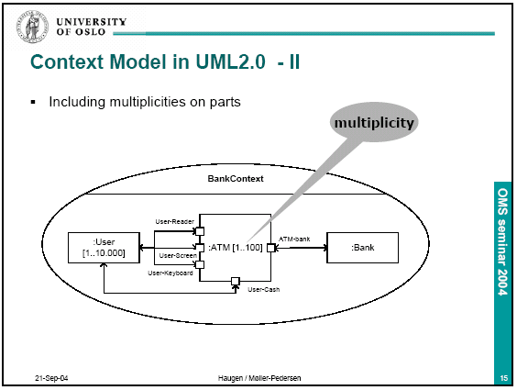

Slide 54
Structural Diagrams
  Class;
  Object
  Component
  Deployment
  Composite Structure
  Package

Slide 55
Packages
Package — general-purpose mechanism for organizing elements into groups.
Nested Elements: Composite relationship (When the whole dies, its parts die as well, but not necessarily vice versa)
(C++ namespace; specialization means “derived”)
simple names
path names
visibility
Client
Client
+ OrderForm
+OrderForm
-Order
enclosing package name
Business rules
+ TrackingForm
package name
- Order
Client
+TrackingForm
textual nesting
graphical nesting
Sensors::Vision
{ version = 2.24 }
Packages that are friends to another may see all the elements of that package, no matter what their visibility.
If an element is visible within a package, it is visible within all packages nested inside the package.
Visibility

Slide 56
Dependency –Among Packages
Two Stereotypes of Dependency Among Packages:
  access: the source package is granted the right to reference the elements of the target package (:: convention)
  import: a kind of access; the public contents of the target package enter the flat namespace of the source as if they had been declared in the source
Client
packageName
+ OrderForm
+ TrackingForm
- Order
<<import>>
<<access>>
exports
<<import>>
Policies
packageName
packageName
+OrderRules
-GUI:Window
imports
subPackageName
PackageClass
GUI
+Window
<<import>>
+Form
#EventHandler

Slide 57
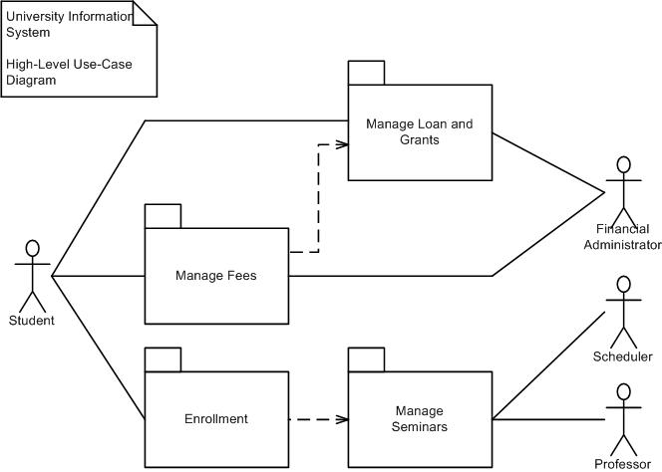
Modeling Groups of Elements
Look for “clumps” of elements that are semantically close to one another.
Surround “clumps” with a package.
Identify public elements of each package.
Identify import dependencies.
Use Case package Diagram
Included and extending use cases belong in the same
package as the parent/base use case
Cohesive, and goal-oriented packaging
Actors could be inside or outside each package
Java.awt
utd.administration
registration
Tools.db
db interfaces
Cloudscape
Oracle

Slide 58
Class Package Diagrams
(http://www.agilemodeling.com/artifacts/packageDiagram.htm)
Classes related through inheritance, composition or communication often belong in the same package
Schedule
<<import>>
Seminar
Registration
<<application>>
<<import>>
Java
Infrastructure
<<technical>>
Student
Contact
Point
<<import>>
<<import>>
<<import>>
Professor
A frame depicts the contents of a package (or components, classes, operations, etc.)
Heading: rectangle with a cut-off bottom-right corner, [kind] name [parameter]
Package Schedule
1..*
1
A frame encapsulates
a collection of collaborating instances or
refers to another representation of such
Seminar
Course
1
1..*
held at
0..*
1
Location
Enrollment
Time

Slide 59
Common Mechanisms
Adornments
Notes & Compartments
Extensibility Mechanisms
  Stereotypes - Extension of the UML metaclasses.
  Tagged Values - Extension of the properties of a UML element.
  Constraints - Extension of the semantics of a UML element.

Slide 60

Adornments
Textual or graphical items added to an element’s basic notation.
Notes - Graphical symbol for rendering constraints or comments attached to an element or collection of elements; No Semantic Impact
Rendered as a rectangle with a dog-eared corner.
See http://www.rational.com for related info.
See smartCard.doc for details about this routine.
May contain combination of
text and graphics.
May contain URLs linking to external documents.
Additional Adornments
Transaction
Placed near the element as
  Text
  Graphic
Special compartments for adornments in
  Classes
  Components
  Nodes
named
compartment
addAction()
Exceptions
Resource Locked
Client
anonymous
compartment
bill.exe
report.exe
contacts.exe

Slide 61
Stereotypes
Mechanisms for extending the UML vocabulary.
Allows for new modeling building blocks or parts.
Allow controlled extension of metamodel classes. [UML11_Metamodel_Diagrams.pdf]
Graphically rendered as
  Name enclosed in guillemets (<< >> )
    <<stereotype>>
  New icon
«metaclass»
ModelElement
Internet
The new building block can have
  its own special properties through a set of tagged values
  its own semantics through constraints

Slide 62
Tagged Values
a (name, value) pair describes a property of a model element.
Properties allow the extension of “metamodel” element attributes.
modifies the semantics of the element to which it relates.
Rendered as a text string enclosed in braces { }
Placed below the name of another element.
Server
{channels = 3}
<<library>>
accounts.dll
{customerOnly}
«subsystem»
AccountsPayable
{ dueDate = 12/30/2002
status = unpaid }
tagged values

Slide 63
Constraints
Extension of the semantics of a UML element.
Allows new or modified rules
Rendered in braces {}.
  Informally as free-form text, or
  Formally in UML’s Object Constraint Language (OCL):
  E.g., {self.wife.gender = female and self.husband.gender = male}
Corporation
Portfolio
Department
BankAccount
{or}
*
*
{secure}
{subset}
Person
id : {SSN, passport}
BankAccount
member
1..*
1
manager
A simple constraint
Constraint across multiple elements
Person
Person
age: Integer
employees
employers
Company
0..*
0..*
Company
self.employees.forAll(Person p |
p.age >= 18 and p.age <= 65)

Slide 64
Appendix
Some Additional Material

Slide 65
Classes: Notation and Semantics
Class - Name
attribute-name-1 : data-type-1 = default-value-1
attribute-name-2 : data-type-2 = default-value-2
operation-name-1 ( argument-list-1) : result-type-1
operation-name-2 ( argument-list-2) : result-type-2
responsibilities
To model the <<semantics>> (meaning) of a class:
Specify the body of each method (pre-/post-conditions and invariants)
Specify the state machine for the class
Specify the collaboration for the class
Specify the responsibilities (contract)

Slide 66
Attributes
Syntax
[ visibility ] name [ multiplicity ] [ : type ] [ = initial-value ] [ {property-string } ]
Visibility
+ public; - private; # protected; {default = +}
type
  There are several defined in Rational Rose.
  You can define your own.
property-string
Built-in property-strings:
  changeable—no restrictions (default)
  addOnly—values may not be removed or altered, but may be added
  frozen—may not be changed after initialization
Or you can define your own: e.g. {leaf}
origin | Name only
+ origin | Visibility and name
origin : Point | Name and type
head : *Item | Name and complex type
name [ 0..1 ] : String | Name, multiplicity, and type
origin : Point = { 0, 0 } | Name, type, and initial value
id : Integer { frozen } | Name and property

Slide 67
Operations
Syntax
[ visibility ] name [ (parameter-list ) ] [ : return-type ] [ (property-string) ]
Visibility
+ public; - private; # protected; {default = +}
parameter-list syntax
[ direction ] name : type [ = default-value ]
direction
  in—input parameter; may not be modified
  out—output parameter; may be modified
  inout—input parameter; may be modified
property-string
  leaf
  isQuery—state is not affected
  sequential—not thread safe
  guarded—thread safe (Java synchronized)
  concurrent—typically atomic; safe for multiple flows of control

Slide 68
Template Classes; Primitive Types
A template class is a parameterized element and defines a family of classes
In order to use a template class, it has to be instantiated
Instantiation involves binding formal template parameters to actual ones, resulting in a concrete class
template parameters
template class
Item
Map
Value
Buckets : int
+ bind( in i : Item; in v : Value ) : Boolean
+ isBound( in i : Item ) : Boolean {isQuery}
explicit binding
Uses <<bind>>
Map< Customer, Order, 3 >
<<bind>> ( Customer, Order, 3 )
implicit binding
OrderMap
Item
Value
Buckets
Primitive Types
using a class notation
<<enumeration>>
Boolean
stereotype
<<dataType>>
Int
false
true
constraint
{ value range
–2**31 to +2**31-1
}

Slide 69
Interface: A Java Example
public interface SoundFromSpaceListener extends EventListener {
void handleSoundFromSpace(SoundFromSpaceEventObject sfseo);
}
public class SpaceObservatory implements SoundFromSpaceListener
public void handleSoundFromSpace(SoundFromSpaceEventObject sfseo) {
soundDetected = true;
callForPressConference();
}
Can you draw a UML diagram corresponding to this?

Slide 70
Package Diagrams: Standard Elements
Façade — only a view on some other package.
Framework — package consisting mainly of patterns.
Stub — a package that serves as a proxy for the public contents of another package.
Subsystem — a package representing an independent part of the system being modeled.
System — a package representing the entire system being modeled.
Is <<import>> transitive?
Is visibility transitive?
Does <<friend>> apply to all types of visibility: +, -, #?

Slide 71
Dependency –Among Objects
3 Stereotypes of Dependency in Interactions among Objects:
  become: the target is the same object as the source but at a later point in time and with possibly different values, state, or roles
  call: the source operation invokes the target operation
  copy: the target object is an exact, but independent, copy of the source

